Slide 1
Practical project
Roman Emperors Web Application

Slide 2
Intro
Methodology/Workflow
CI Pipeline
Demo
Review - areas to improve
Questions

Slide 3
New skills learned
Spring Boot
JavaScript
HTML/CSS
Selenium
IntelliJ
Visual Studio Code
Postman

Slide 4
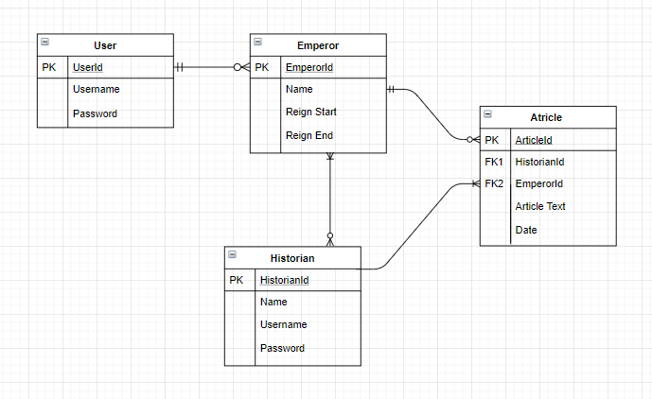
ERD

Slide 5
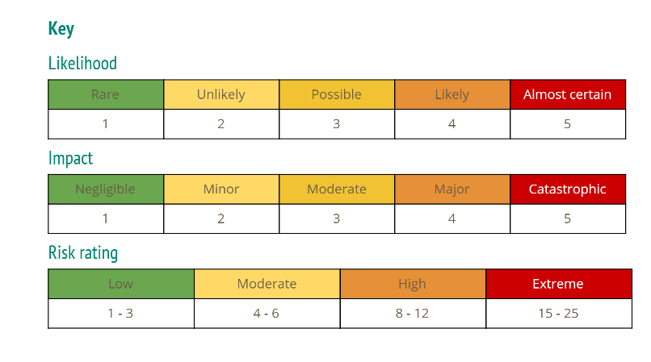
Risk Assessment

Slide 6
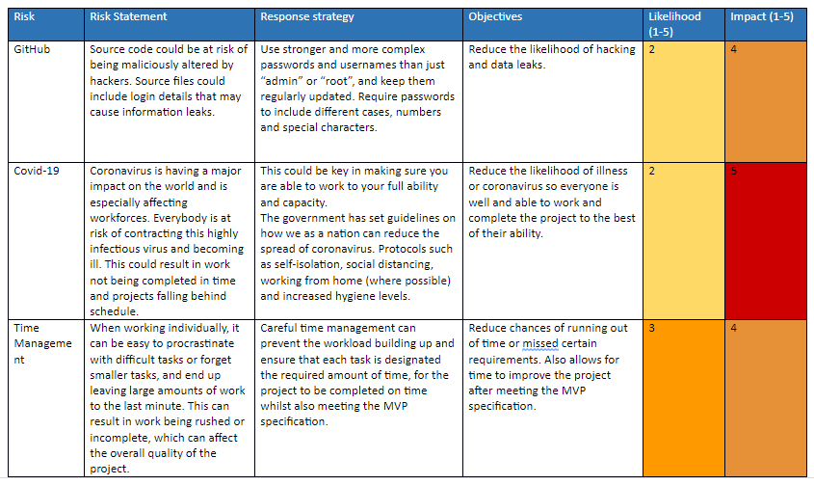

Slide 7
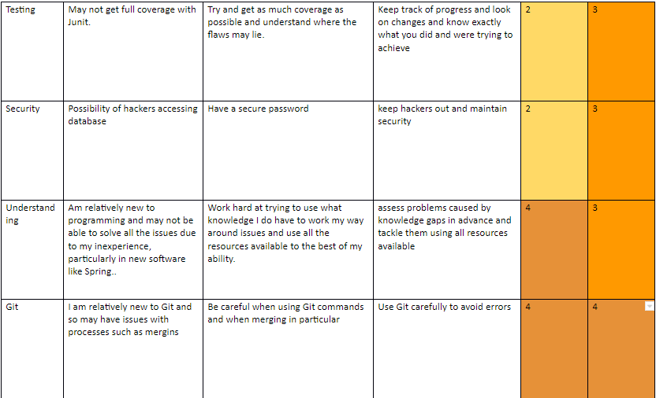

Slide 8
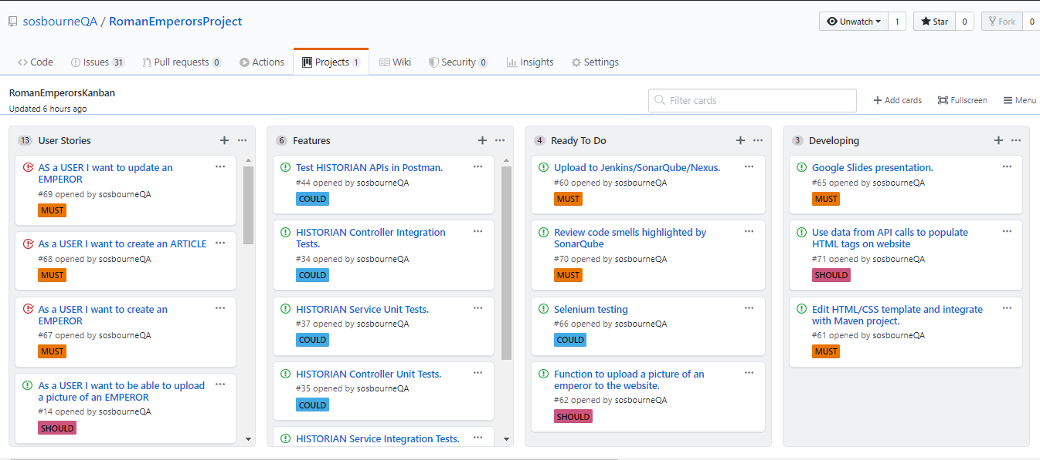
Kanban Board

Slide 9
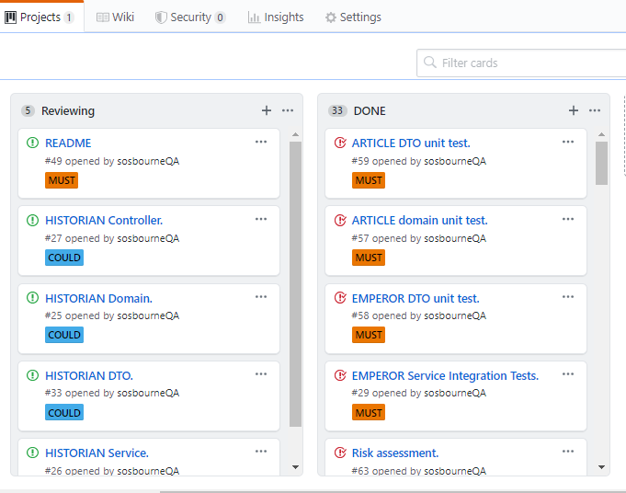

Slide 10
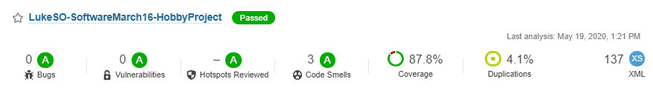
SonarQube
Powerful Static Analysis tool

Slide 11
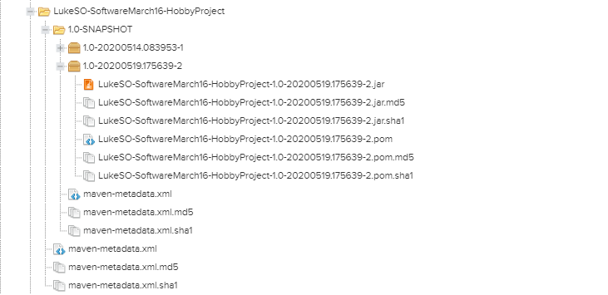
Nexus

Slide 12
Demo
Show code structure
View application in ‘localhost:8181’
Show database

Slide 13
Areas to Improve
Add extra functionality to make the application more suitable for public release - entities for User and Historian.
Improve test coverage - implement Selenium.
Develop front-end further - improve knowledge of JavaScript in particular to increase the functionality of the web-application.
Make more use of GitHub features

Slide 14
Questions?

